Slide 1
Exemplary CAR – 143913065 Chris Nicastro

Slide 2
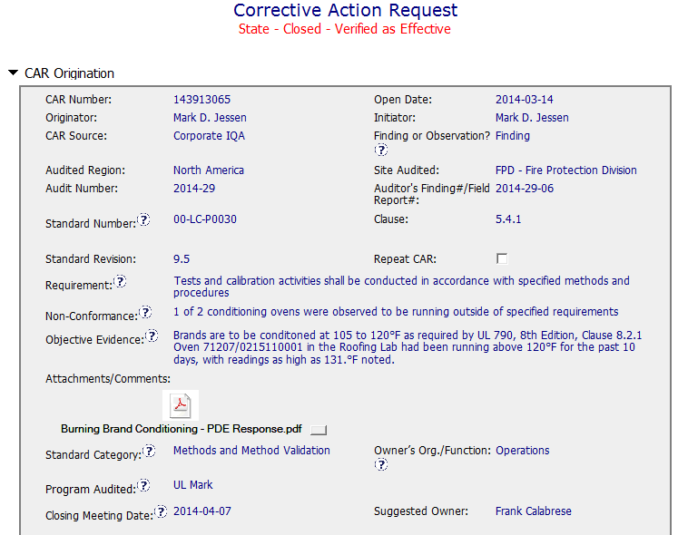
CAR 143913065 - Finding
Clear Requirement, NC, and OE

Slide 3
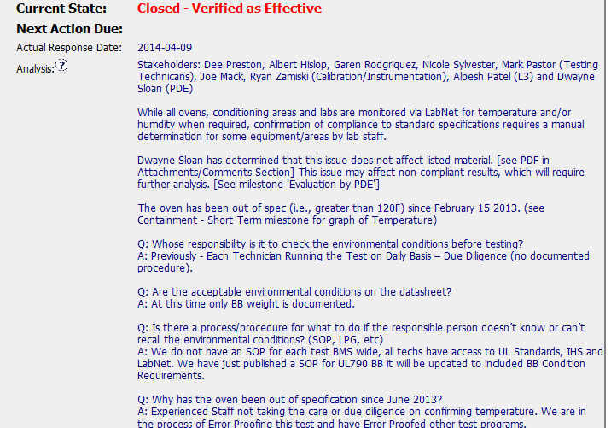
CAR 143913065 - Finding
Stakeholders and their roles identified.
Identifying manual steps helps to create a good CAP.
PDE Determination of the Scope of the issue – were previously completed tests affected by the out of spec burning brand oven?
Scope of the issue determined (timeframe)

Slide 4
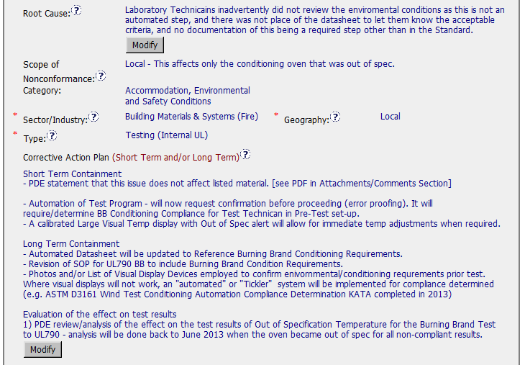
CAR 143913065 - Finding
RC is clear – it identifies why there is an issue and some items that could be improved that led to the NC.
Automation of Test Program – Application Validation!!! Excellent. We are not perfect – applications with validation at the right steps can fix most of our issues.
Long Term Containment – excellent steps to ensure that this issue does not occur again.

Slide 5
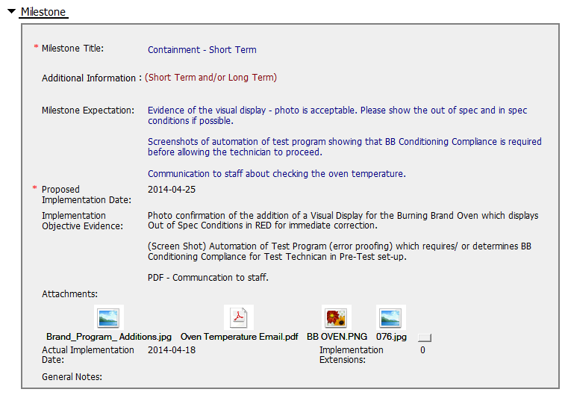
CAR 143913065 - Finding

Slide 6
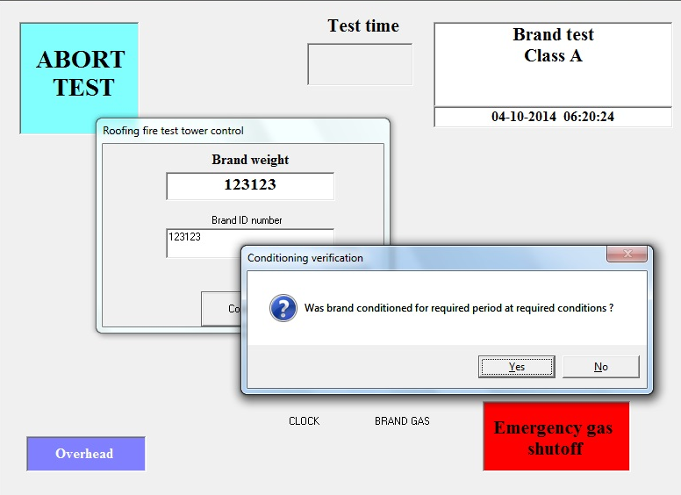
CAR 143913065 – Finding –
Containment Milestone – affirmation of temperature being in spec

Slide 7
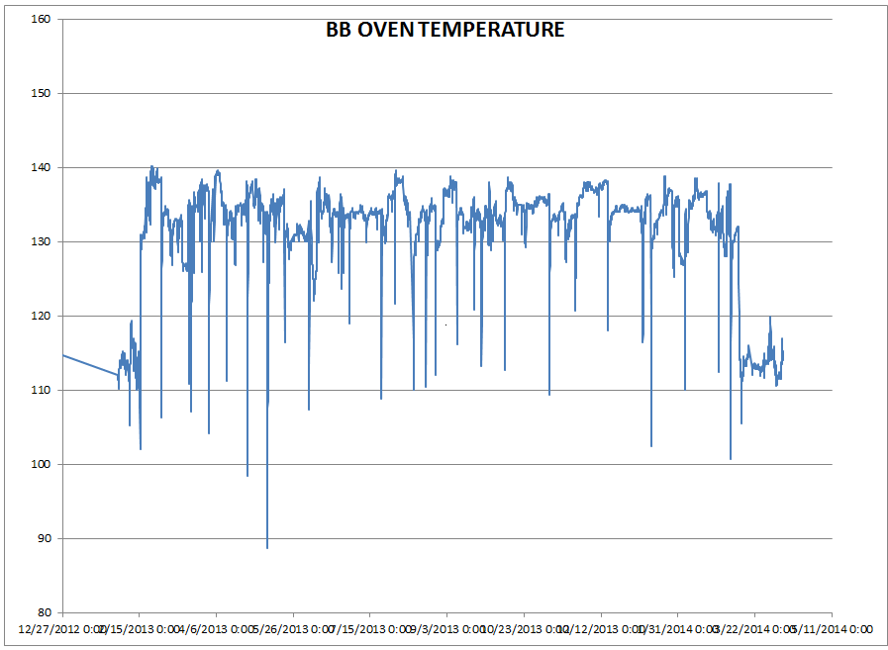
CAR 143913065 – Finding –
Containment Milestone –
supports the analysis (referenced by the analysis)

Slide 8
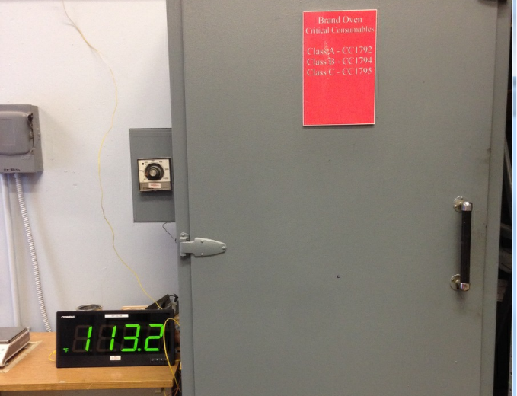
CAR 143913065 – Finding –
Containment Milestone – Visual display of temp

Slide 9

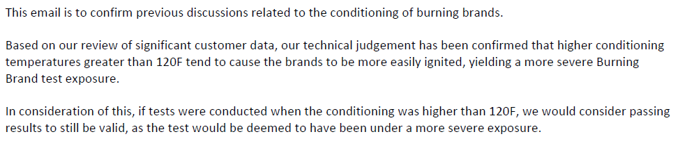
CAR 143913065 – Finding –
PDE Determination – Scope of Non-Conformance

Slide 10
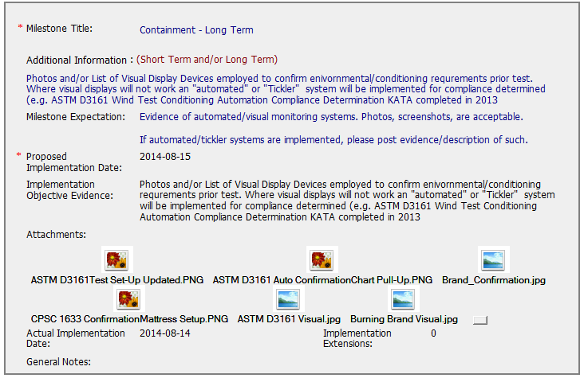
CAR 143913065 – Finding –
Containment – Long Term
Evidence of visual display items to confirm the test requirements for temperature.

Slide 11
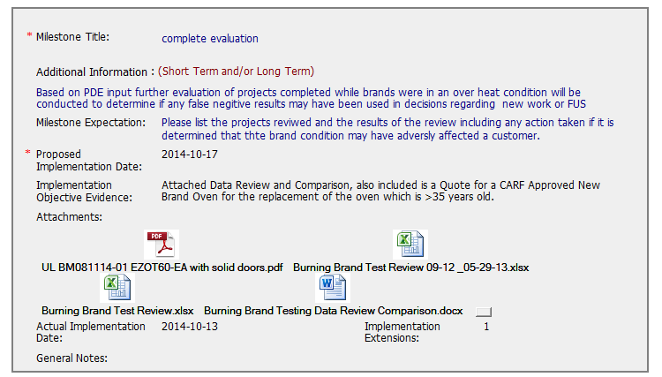
CAR 143913065 – Finding –
PDE Input – evaluation – false non-conformances?
Using data from before the non-conformance existed (i.e., when the burning brand oven was ‘out of spec’ versus when the burning brand oven was ‘in spec’), the rate of test failures was determined. There was no significant change in the percentage of failures during the in and out of spec conditions, this information was used to support the PDE determination.
In addition, a quote for a new oven is attached, with an approved CARF. The current oven was over 35 years old.

Slide 12
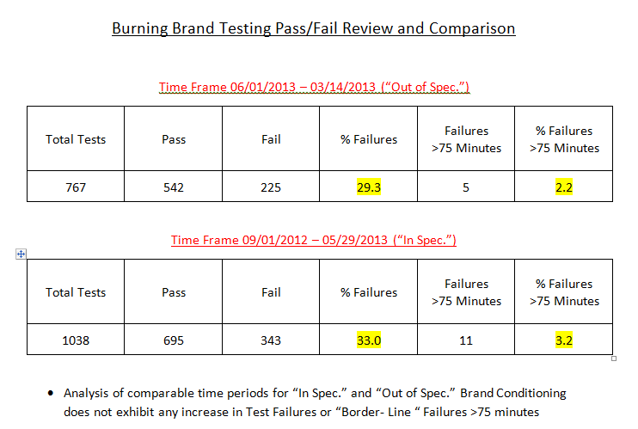
CAR 143913065 – Finding –
PDE Input – evaluation – false non-conformances?

Slide 13
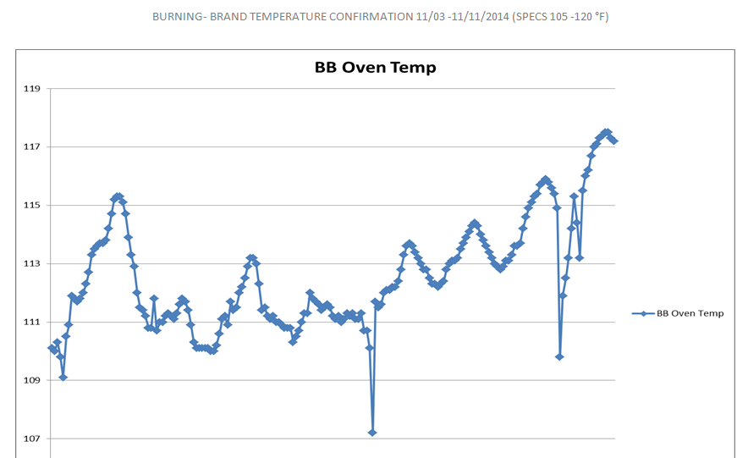
CAR 143913065 – Finding –
Owner’s Verification

Slide 14
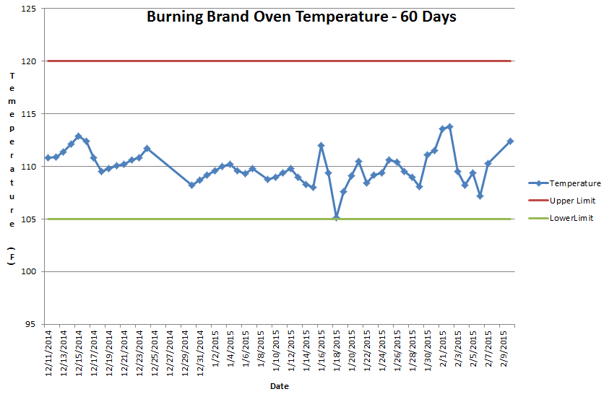
CAR 143913065 – Finding –
Auditor Verification – 60 days of temperature monitoring

Slide 15
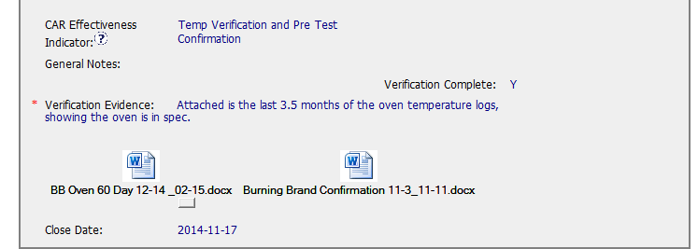
CAR 143913065 – Finding –
Auditor Verification
CAR 143913065 – CAR “Health”
No overdue notices and/or escalations!
No Extensions!
CAR was sent back after the initial response was submitted, in order to obtain more detail.
Given that the issue is specifically in regards to the Burning Brand Oven being between 105F and 120F, the verification only includes ensuring the temperature of the oven, to make sure no tests were conducted in an out of spec condition. The visual confirmations and warnings of an out of spec condition support the effectiveness of the actions taken.

Slide 16
CAR 143913065 – CBS Check
CBS Requirements | Excellent | Moderate | Need Improve | N/A
(C) Extensions are within requirement (<30 days, 3 or less) | X
(T) Most appropriate ‘category’, ‘type’, ‘geography’ are selected | X
(P) Facilitates the handling of disputed CARs |  |  |  | X
(T) Acts on CARs within required timeframe | X
(C) Analysis shows clear path to root cause and scope; stakeholders identified | X
(C) Root cause statement is succinct, reasonable, complete (Shows ‘N/A’ for observations) | X
(C) Corrective actions fix the objective evidence and other problems found; address entire root cause and scope. For observations, they do not go beyond fixing the objective evidence | X
(C) Milestones address containment & owner’s verification; completed per milestone expectations | X
(P) Verification per requirements | X
(L) Referenced communications are attached as needed | X
(C L) Evidence of communication for overdue/escalated CARs and other pertinent concerns |  |  |  | X
(P) Trains other CAR Champions |  |  |  | X

